Slide 1

#LifeKoKaroLift
Data Science Certification Program

Slide 2


Course : Data Science
Lecture On : Pandas
Instructor : Shivani Kapania

Slide 3
In Last Class, we covered….
Concatenating dataframes
Merging dataframes

Slide 4
Today’s Agenda
Group-by
Lambda functions

Slide 5
Group by
By “group by” we are referring to a process involving one or more of the following steps:
Splitting the data into groups based on some criteria.
Applying a function to each group independently.
Combining the results into a data structure.
In the apply stage, we might want to:
Aggregate
Transform eg z scoring
Filter etc

Slide 6
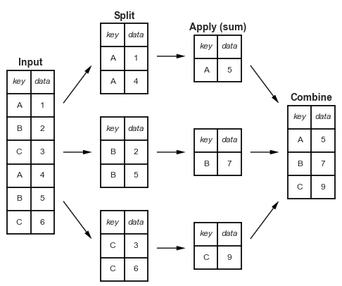
Split-apply-combine

Slide 7
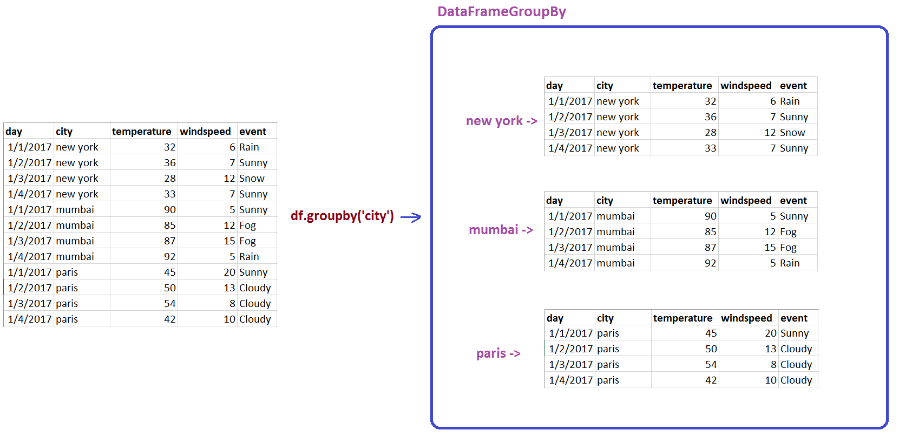

Slide 8
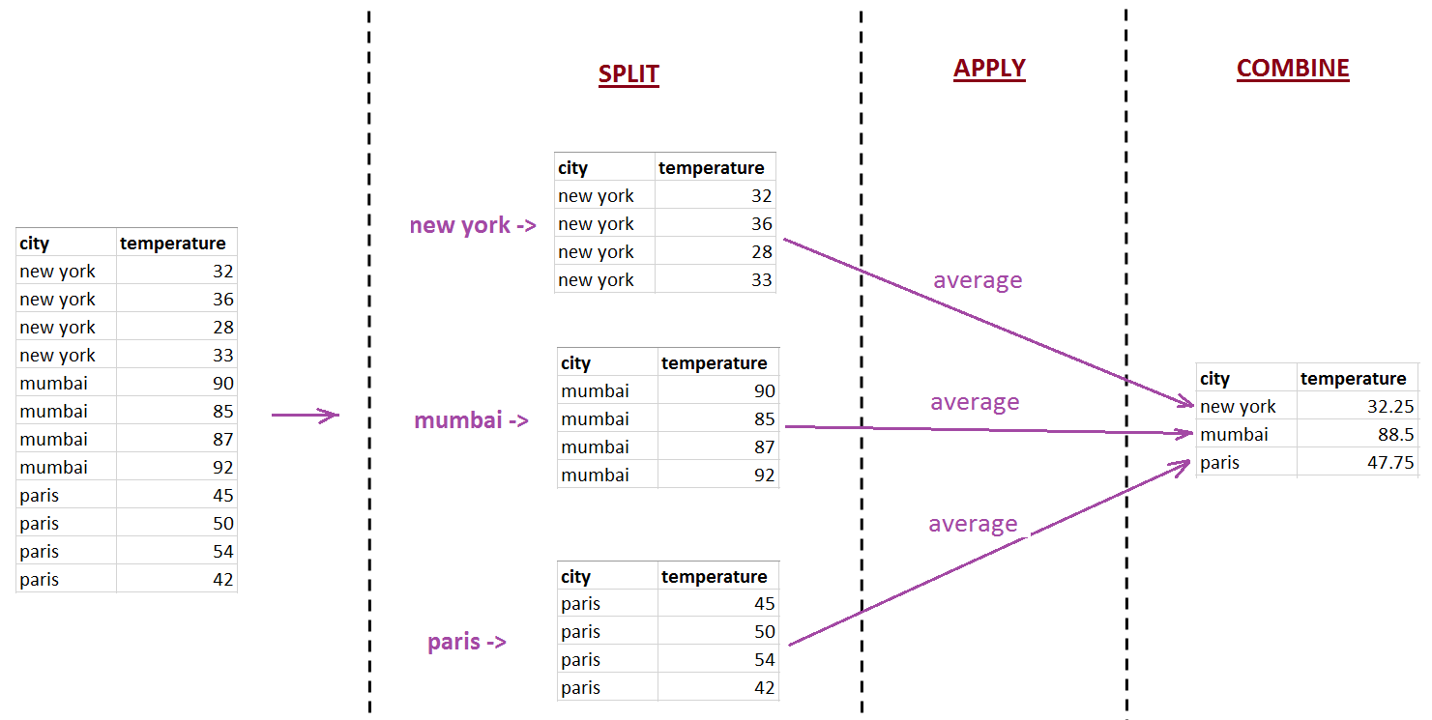
Split-apply-combine

Slide 9
#LifeKoKaroLift
Thank You!

